Slide 1

JSDoc
Documentation generator for JS/TS code

Slide 2
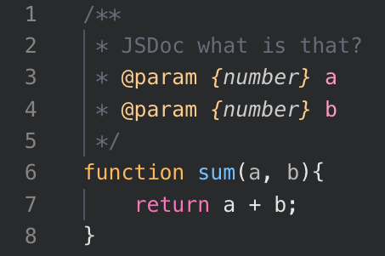
What’s JSDoc
JSDoc is a documentation generator for JavaScript, allowing developers to annotate their code with comments that can then be transformed into comprehensive HTML documentation.
By providing a standardized way to document code, JSDoc helps developers create readable and maintainable codebases. The primary purpose of JSDoc is to describe the structure, functionality, and intended usage of JavaScript code, making it easier for developers to understand and use the code effectively.

Slide 3
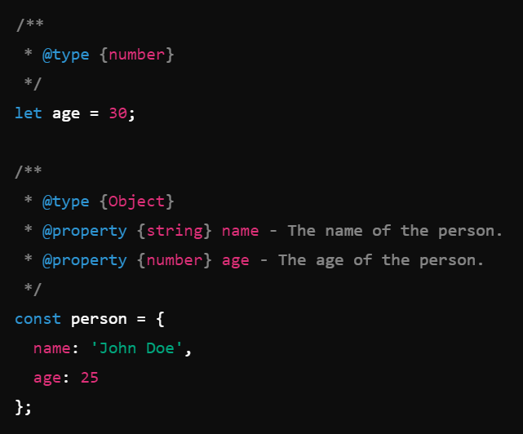
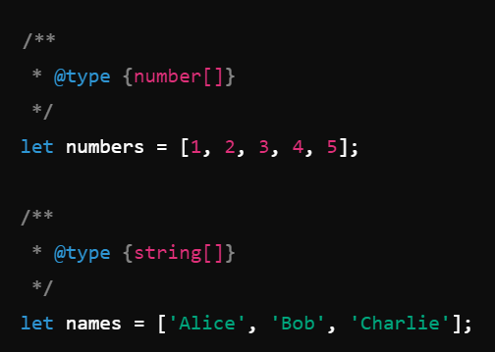
Basic Syntax and Tags
JSDoc comments are typically placed above the code they describe and are enclosed within /** ... */ blocks. Here are some common tags used in JSDoc, along with examples: @param: Describes a function parameter.
@return or @returns: Describes the return value of a function.
@type: Specifies the type of a variable, parameter, or return value.
@property: Documents properties of an object.
@typedef: Defines custom types.
Example – Greeting component

Slide 4
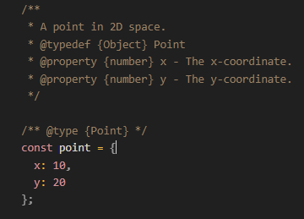
Typing objects and nesting
JSDoc allows us to generate interfaces for the objects and store and export them globally.
The main disadvantage of this is that we lose the autocomplete in the IDE and if we store the types in another file we need to manually look for them.
Example – Farewell Component

Slide 5
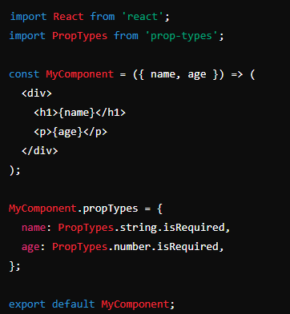
PropTypes
PropTypes is a type-checking library for React (Split from react in version 15.5.0), used to validate the props passed to a component.
PropTypes helps ensure that the props received by a component are of the correct type and meet certain requirements, thereby catching potential bugs and making the code more robust.
To use PropTypes, you need to install the prop-types library and import it into your React components.
Example – Greeting component

Slide 6
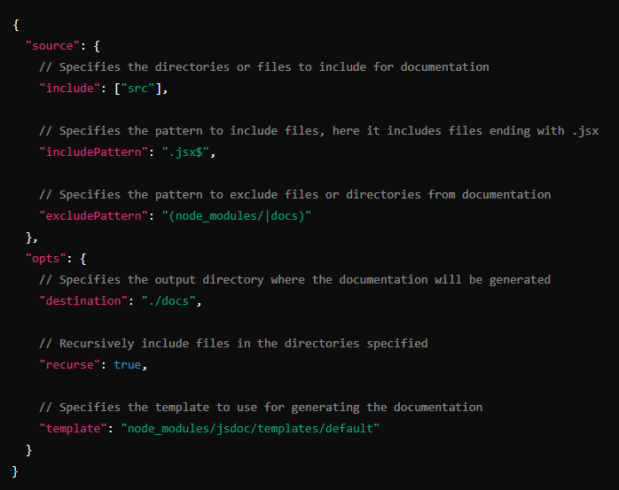
Documentation Generation
With this simple command we can automate documentation generation:
This command will use the config file with the selected preferences to generate html documentation.

Slide 7
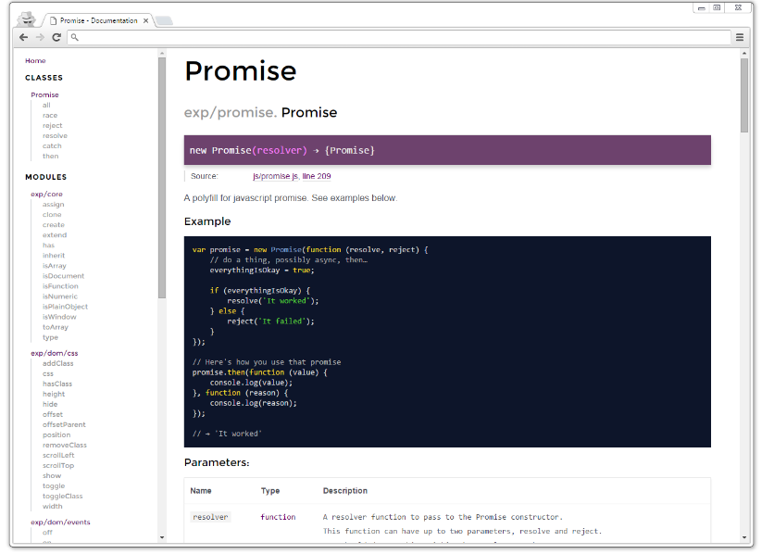
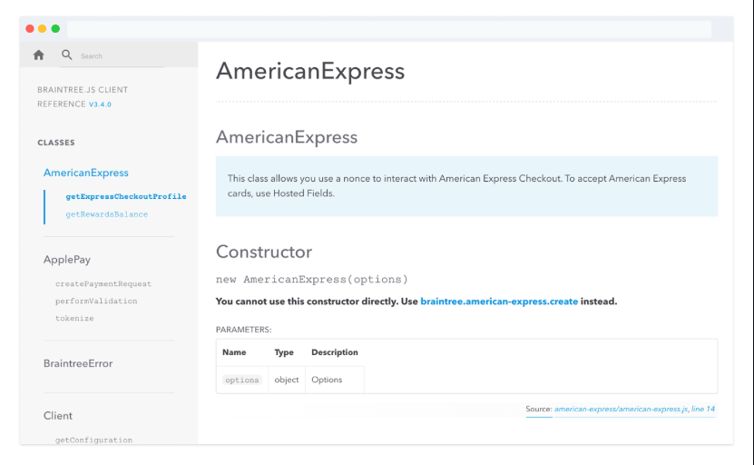
Templates
DOCDASH
https://github.com/clenemt/docdash
JSDOC-TEMPLATE
https://github.com/braintree/jsdoc-template

Slide 8
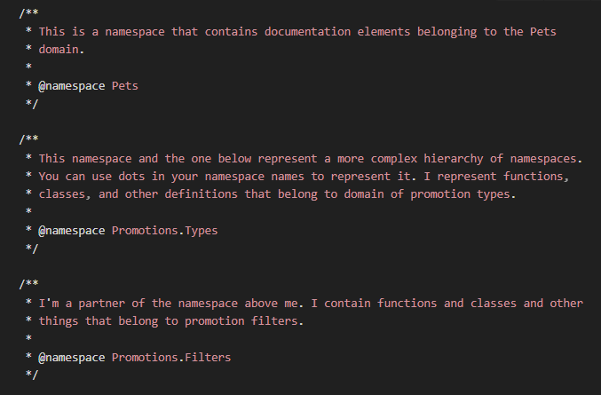
Namespaces
JSDoc namespaces provide a way to organize and group related functions, variables, and objects within JavaScript code.
By using namespaces, you can create a hierarchical structure to better organize your codebase.
Namespaces are documented using @namespace tag in JSDoc comments, followed by a brief description of the namespace's purpose.
Inside a namespace, you can document functions, variables, and objects using @memberof tag to indicate their belonging to that namespace.
This helps improve code readability and maintainability by clearly defining the scope and purpose of different parts of your JavaScript code.

Slide 9
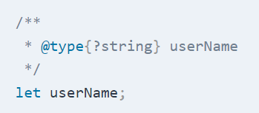
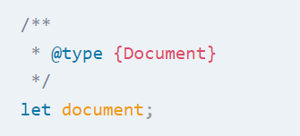
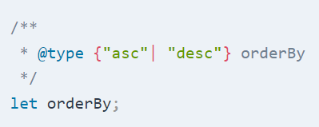
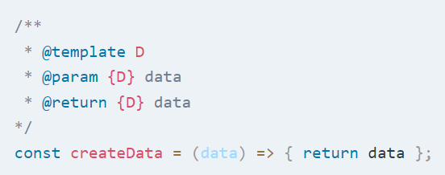
Advance usage
Nullable types | Built-in objects JsDoc allows you to reference the standard built-in objects in JavaScript such as Promise, Document, Window etc.
Union Types | Generic Types

Slide 10
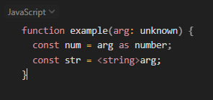
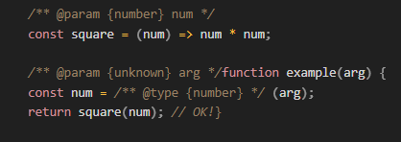
Advance usage: Type Casting
Type casting in TypeScript can be done using expression as T or <T>expression:
Type casting in JSDoc is done by wrapping the expression in parentheses and
adding a preceding @type comment:

Slide 11
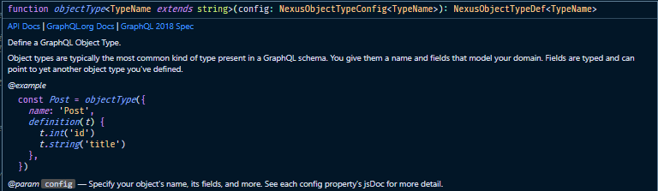
Advantages
Great replacement for Typescript in old projects
Automatically generates docs.
Self-explanatory / Integration with IDE.
Avoid build steps in huge projects.

Slide 12
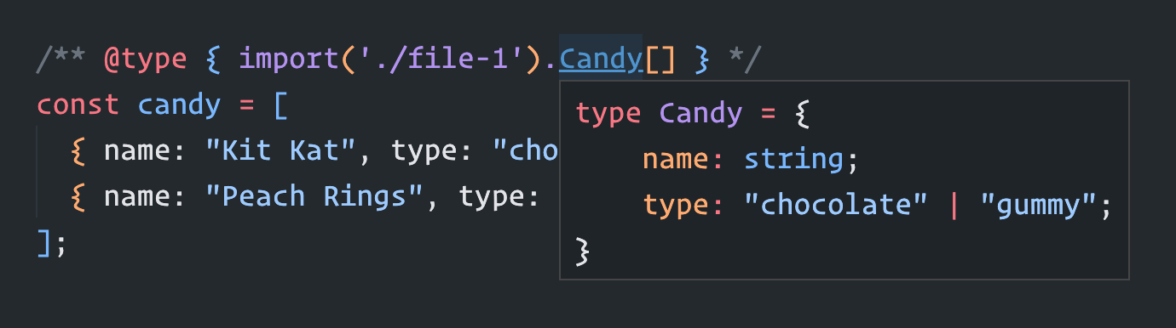
Disadvantages
Verbose
Complex types or Generics can be messy
Needs at least propTypes to have linting

Slide 13

RECOMMENDED EXTENSIONS FOR VSCODE
JSDoc Generator: Automatic JSDoc generator for JavaScript, TypeScript and Typescript/JavaScript React.
DOWNLOAD LINK
https://marketplace.visualstudio.com/items?itemName=crystal-spider.jsdoc-generator

Slide 14
References
https://alexharri.com/blog/jsdoc-as-an-alternative-typescript-syntax https://medium.com/swlh/creating-better-jsdoc-documentation-8b7a65744dcb
https://www.prisma.io/blog/type-safe-js-with-jsdoc-typeSaf3js
Why Svelte moved to JSDoc from TS https://www.youtube.com/watch?v=zPOHY-cZ1wE
https://www.youtube.com/watch?v=zPOHY-cZ1wE

Slide 15
Thank you!

